Slide 1
Enterprise Visibility and Control
Getting Started With Release Modeling

Slide 2
Session Abstract
On the road to Continuous Delivery and/or DevOps? Just want to deliver better software faster? Pipelines are a key to achieving these goals because going fast and still producing quality output requires better visibility, coordination, and control. There is confusion out there on how best to use pipelines, and where they should be used. I’ll separate the ideal from the reality so you can figure out your next steps. During this talk we will demonstrate how ElectricFlow can provide visibility to all stakeholders, coordinate multiple people and automations, and control what gets released into production environments.

Slide 3

Enterprise Releases
Are Complicated

Slide 4
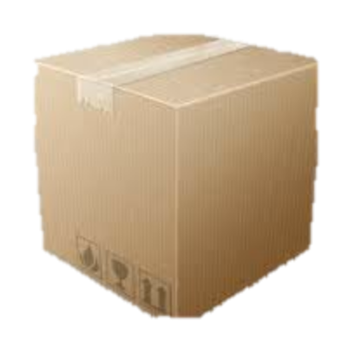
The enterprise CD reality – Multiple apps
CI
Dev
A
SCM
Build
Unit / Code Analysis
Publish Artifacts
Commit Pipeline
Uncontrolled Environments
Controlled Environments
A
A
A
B
C
B
C
Integ
Testing
Pre-Prod
Prod
App 1
App 2
B
C
A
App 1
B
C
App 3
Release Pipeline

Slide 5
The enterprise CD reality – Multiple apps
Commit Pipelines
Release Pipeline
Dev
A
SCM
Build
Test
Publish
Uncontrolled Environments
Controlled Environments
Dev
B
SCM
Build
Test
Publish
Integ
Testing
Pre-Prod
Prod
Dev
C
SCM
Build
Test
Publish
. . .

Slide 6
Enterprise Release Manager/Engineer Challenges
No top down visibility or predictability
Complex multi-application dependencies
Too many release details to track
Can’t keep track of what is where
Coordination of tasks across teams
Integrations with tools and technologies
Release Velocity
Time to Market
Innovation

Slide 7
Release Manager/Release Engineer Challenges
“I need to release not just one single application, but multiple applications successfully on the game day.”
“ I have to support traditional releases side by side with DevOps Initiatives that have much faster release cycles.”
“I need to control and communicate the exact release payload and version, and know what has been deployed to which environment.”
“I need top down visibility so I don’t have to dig around to find out how my release is doing, where it’s stuck, or who it’s waiting for.”

Slide 8

The solution?
Frequent, small batches
Automated everything
Multiple dynamic environments
Loosely coupled components
Containers, micro-services
“12-factor” Apps
“Go West, young man”
Traditional Release Mgmt
DevOps
Continuous Delivery
“Big Bang” release planning
Multiple environments
Enterprise release calendar
Risk & Impact analysis
Resource reservations
Release plan approvals
Automate everything
Adopt CD practices
Adopt CD architectures
Adopt the cloud
Change the culture
Notes:
Cover the idea of IOT vs. Web targets

Slide 9
Enterprise customers
Complex use cases, “n” Applications
Frequent, small batches
Automated everything
Multiple dynamic environments
Loosely coupled components
Containers, micro-services
“12-factor” Apps
Traditional Release
Management Tools
Enterprise Customers
Traditional Release Mgmt
DevOps
Continuous Delivery
“Big Bang” release planning
Multiple environments
Enterprise release calendar
Risk & Impact analysis
Resource reservations
Release plan approvals
CD Pipeline Tools
Simple use case, Few Applications
Notes:
Cover the idea of IOT vs. Web targets

Slide 10

There is no DevOps big bang
Everyone doesn’t change at once

Slide 11

Releases still need to happen
So now you have to support both release styles
(and everything in-between)
Notes:
If you want a unified view across all releases,
And a solution that will evolve to CD with you,
Find one tool that supports all release styles.

Slide 12
Enterprise Solution
Complex use cases, “n” Applications
Frequent, small batches
Automated everything
Multiple dynamic environments
Loosely coupled components
Containers, micro-services
“12-factor” Apps
Traditional Release
Management Tools
Enterprise Customers
ElectricFlow Release
Traditional Release Mgmt
DevOps
Continuous Delivery
“Big Bang” release planning
Multiple environments
Enterprise release calendar
Risk & Impact analysis
Resource reservations
Release plan approvals
CD Pipeline Tools
Simple use case, Few Applications
Notes:
Cover the idea of IOT vs. Web targets

Slide 13




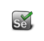




























ElectricFlow Release: Built on Proven Platform
BUILD/TEST
FLEXIBLE AND SCALABLE AUTOMATION FOR DEV AND QA
DEPLOY
ANY APP. ANY VERSION. ANYWHERE. ANYTIME.
RELEASE
TRADITIONAL AND CD PIPELINES AND RELEASES
OTHER
ORCHESTRATE ANY TOOLCHAIN OR PROCESS.
DSL, CLI, REST, SOAP, HTTP, API, SDK
DEV
OPS
ElectricFlow
DEVOPS AUTOMATION PLATFORM
SHARED CONTROL | SHARED VISIBILITY | SHARED RESOURCES
EXTENSIBLE
SCALABLE
SECURE
FLEXIBLE
TRANSPARENT
HYBRID CLOUD
Plugs right in to
your existing tools

Slide 14



ElectricFlow 6.1 Release
Visibility - How close to production is the software? Where is it having problems? What versions are where?
Coordination – Who or what is working on which part of the release? What are all the details? What needs to be done next?
Control – Is the software ready for production? Have all the quality gates been passed and the right people approved?
Notes:
Visibility – How close to production is the software? What other team’s output are we dependent on? How are they progressing? What has been tested where?
Feedback – What is the quality of the software? What tests got run on it? How many times did it fail on the way to production? How long is it likely to take?
Control – Don’t let the software into production until it’s passed all tests. UAT must happen before the software is released. Did Dev do static analysis before passing the software to QA?

Slide 15

Release Conceptual Model
Release Pipeline
Release
Bill of Materials
Teams
SIT
G
UAT
G
Prod
A
A
A
B
C
B
C
B
C
Team 1
Team 1
App 1
App 2
App 3
Environments
Schedules
Deploy App 1
Adjust LB
Backup DB
Deploy App 1
SIT
(Env 1)
Test
(Env 2)
Prod
(Env 3)
Deploy App 1
Deploy App 2
Release Pipeline
Deploy App 2
SIT
G
UAT
G
Prod
Deploy App 2
Deploy App 3
Deploy App 3
Flush caches
Deploy App 1
Deployment
Plans
Load Test Data
Deploy App 2
Deploy App 3
Smoke Test
Deploy App 3
Test
Setup Monitors
Notes:
Deploy
Distribution, installation, and configuration of software bits of one application to servers
Deploy is an action targeted to deploy one app to 1 environment at a time
Release
The act or plan which coordinates people, processes, and content for software delivery into production environments.
Releases often contain >1 application to be deployed in coordination.
Releases often coordinate manual tasks across teams.
Releases coordinate multiple deployments across the SDLC

Slide 16
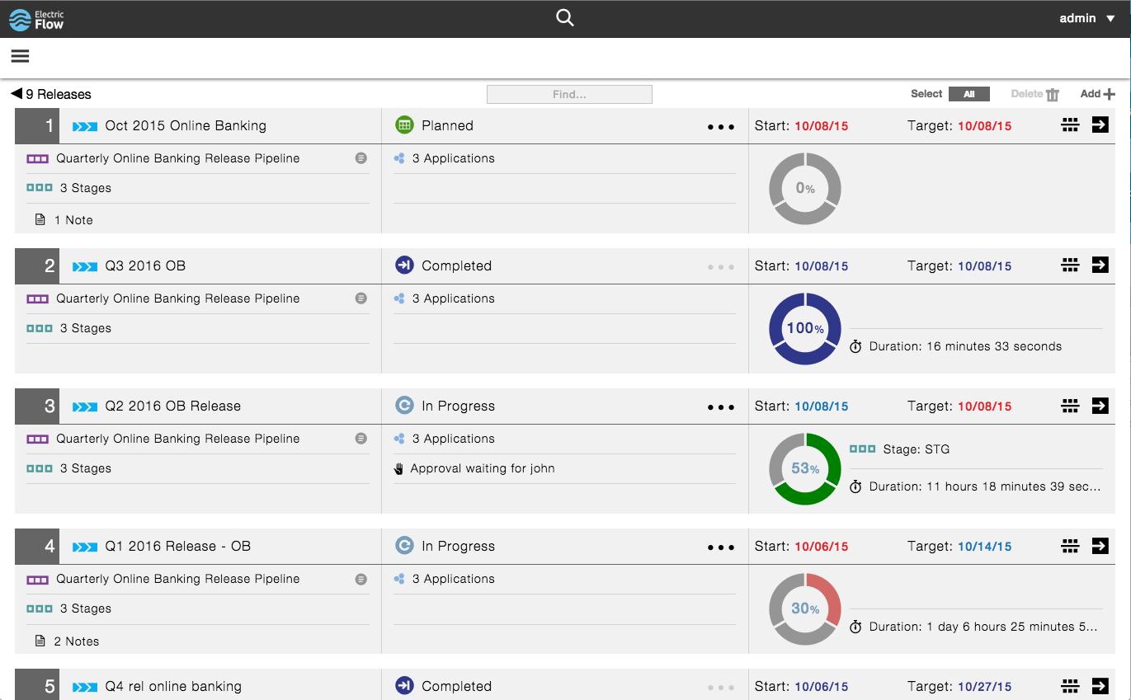
Get a bird’s eye view of all releases
See enough to focus in, with high level release summary
Quick glance of execution status (pipeline)
Know instantly if the release is waiting for someone
Track start and end schedules
Track release duration
Notes:
Gain visibility of overall release status and health for all releases

Slide 17
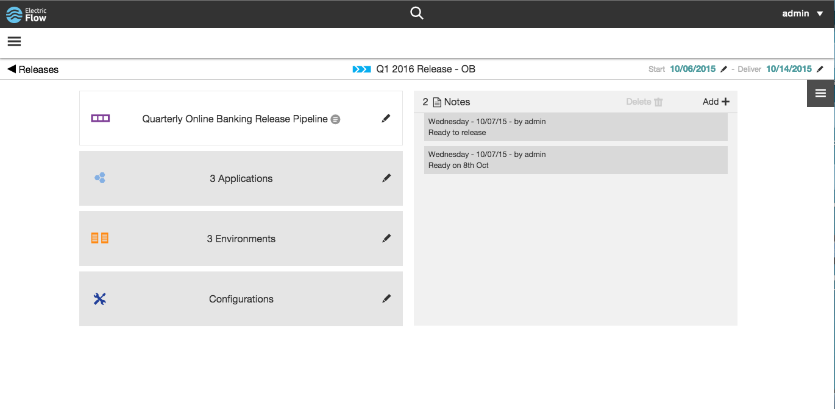
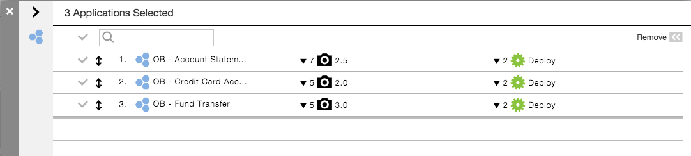
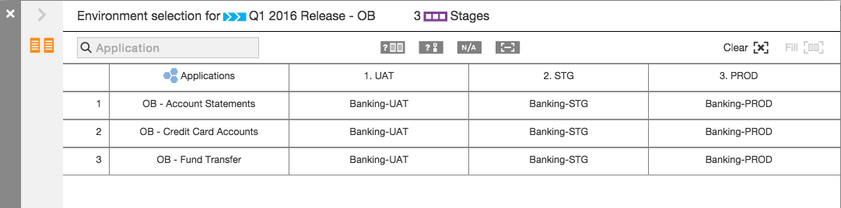
Manage multi-application enterprise releases
Handles multiple interdependent monolithic apps and loosely coupled micro-services
Keep track of the apps tht are part of the release (BoM)
Assign environments or cloud templates
Capture all release Application configurations
Communicate with team members and stake holders using notes
Notes:
Centrally capture all configuration inputs of complex multi-app releases

Slide 18
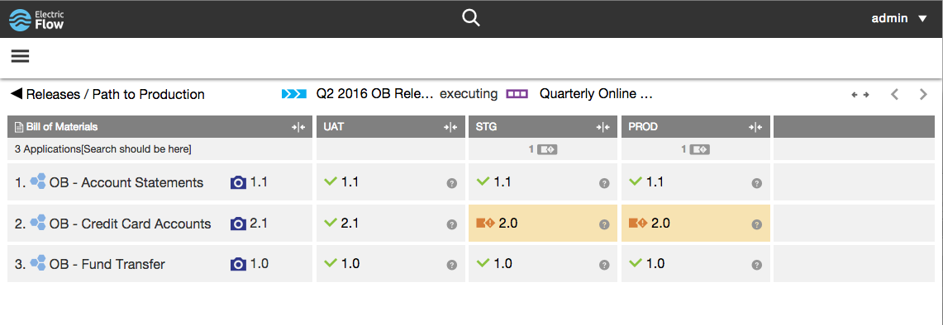
Always know what version is where
See what versions are where for all applications in the release, across all environments
Quickly zero in on areas not matching the Release bill of materials with auto highlights
Get all the details with drill down to Application snapshot details
Stay up to date, always reflects current release state
Notes:
Always know what is deployed to which environments across your releases

Slide 19
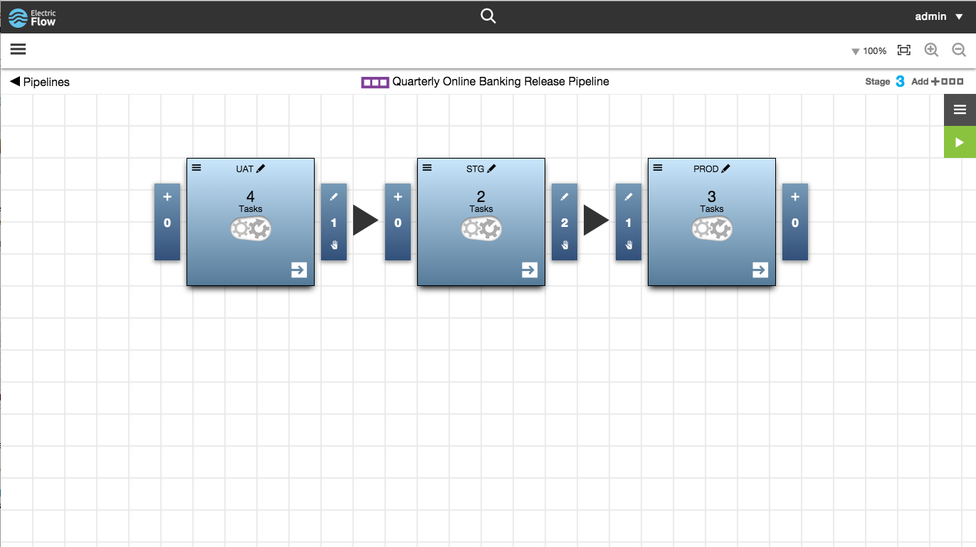
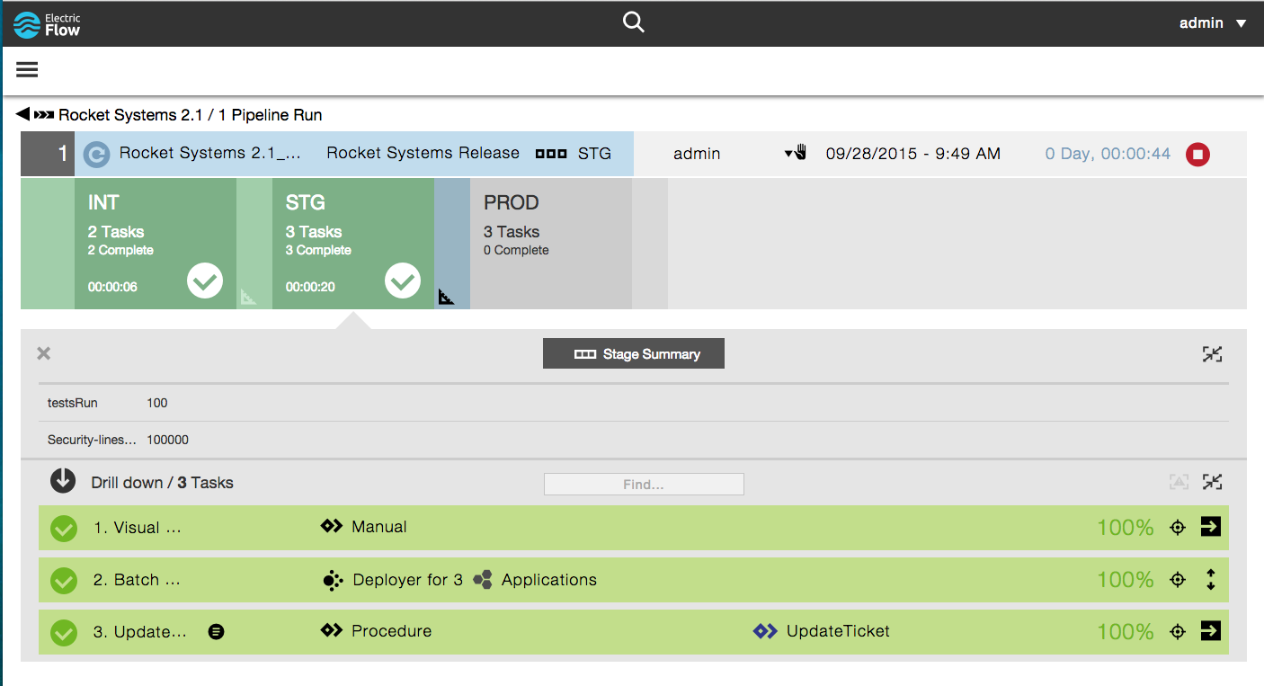
Pipelines control the release flow
Control the progression of quality software to production with stages and gates
See everything with high level visibility and quick drill down troubleshooting
Notes:
Gain increasing confidence, at each stage, of the production readiness of the software to be released

Slide 20
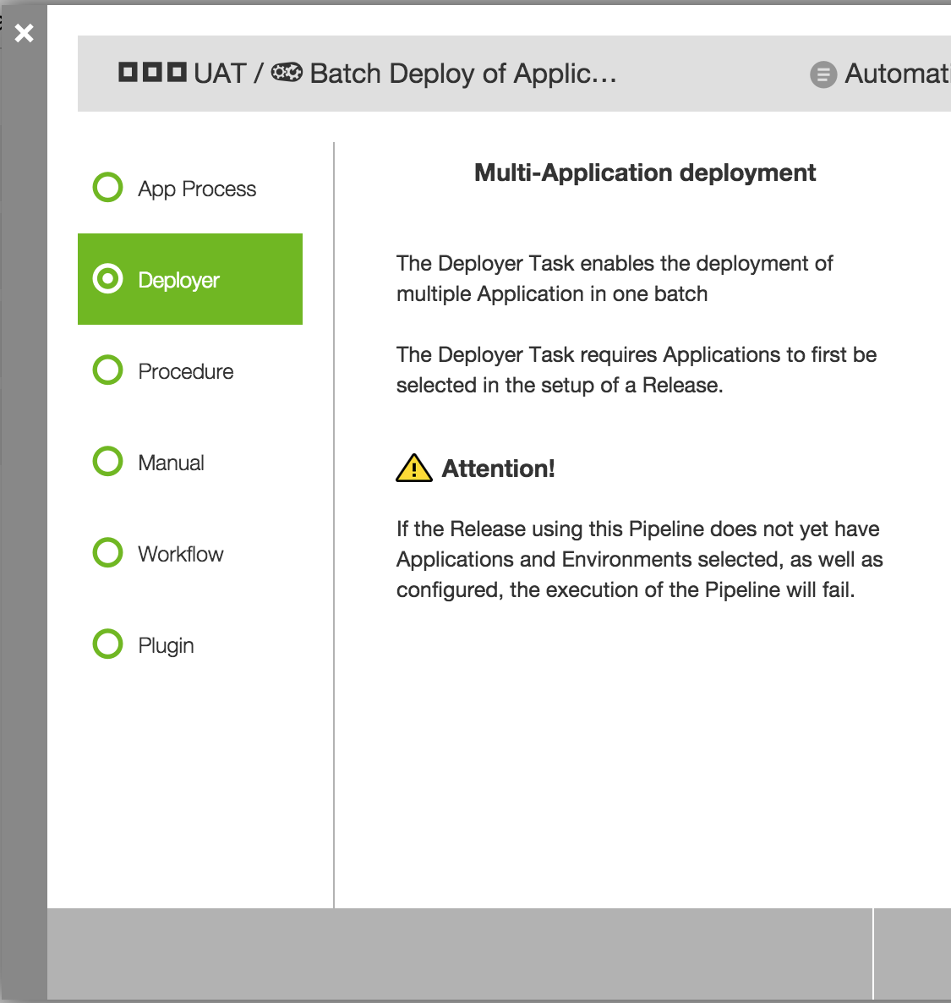
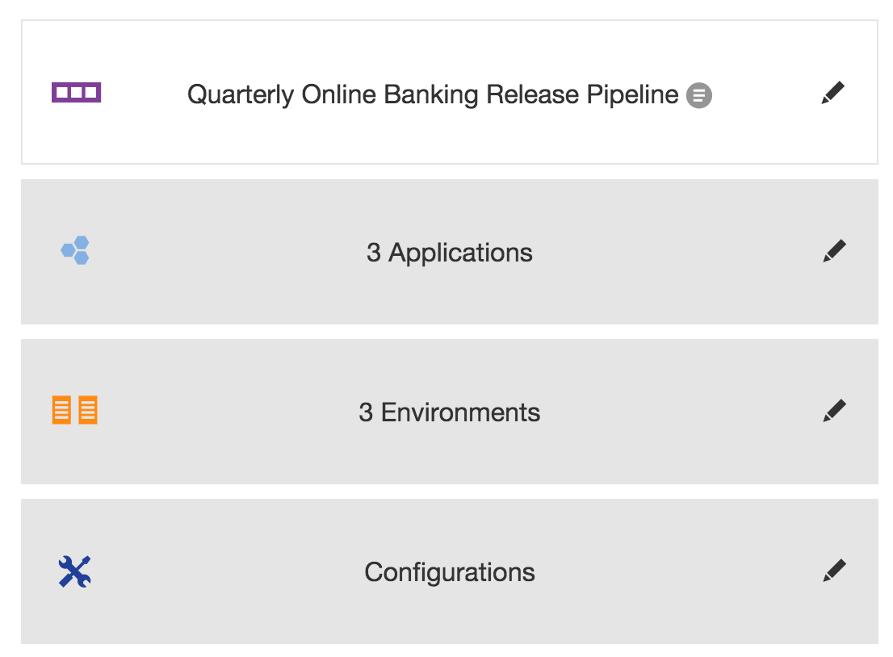
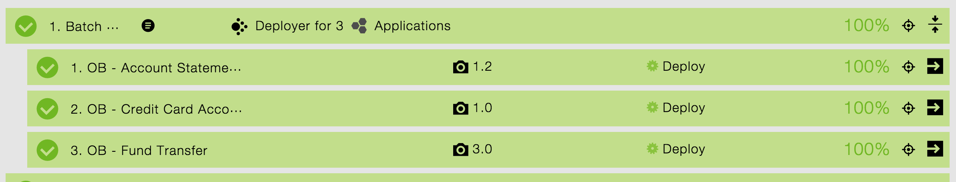
Batch application deployments (Deployer)
Defined as a task in a pipeline stage
Binds to release inputs at deployment time
Enables re-usable release pipelines
+
Notes:
Track release tasks (manual and automated) and their responsible teams

Slide 21
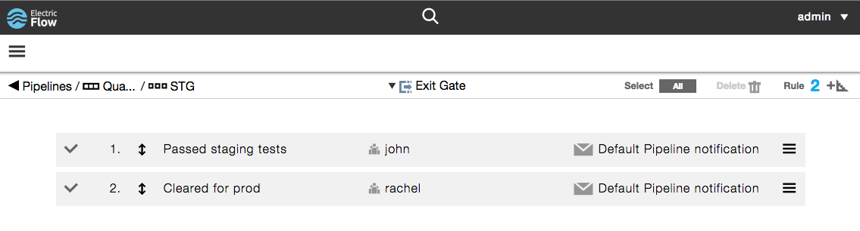
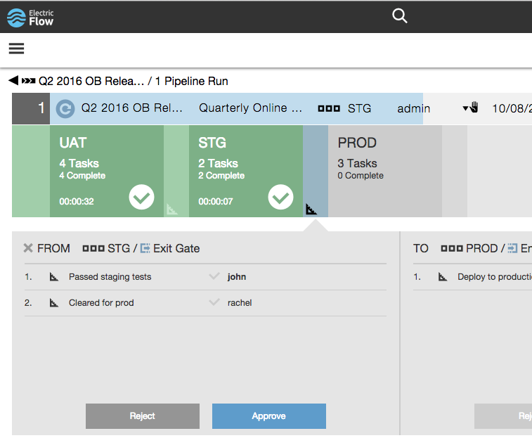
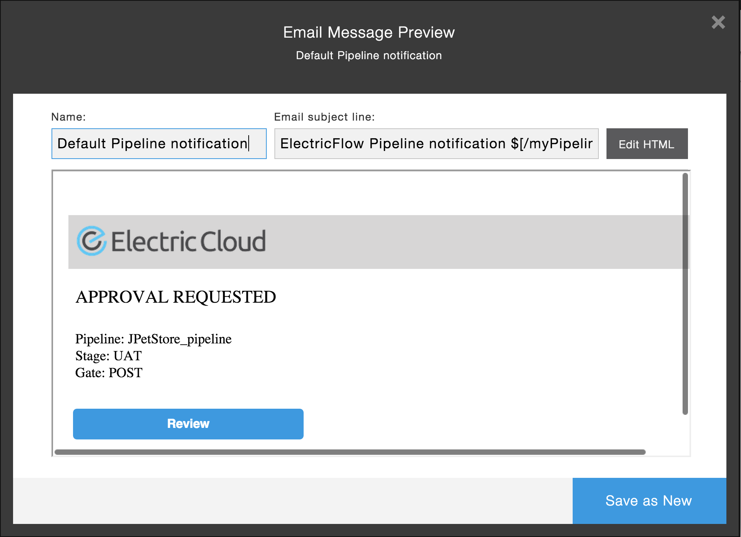
Control progression using manual approvals
Keep humans in the loop using entry and exit gate approvals
Customize the approval notifications with the needed info
Notes:
Enforce quality gates and approvals between stage promotions

Slide 22

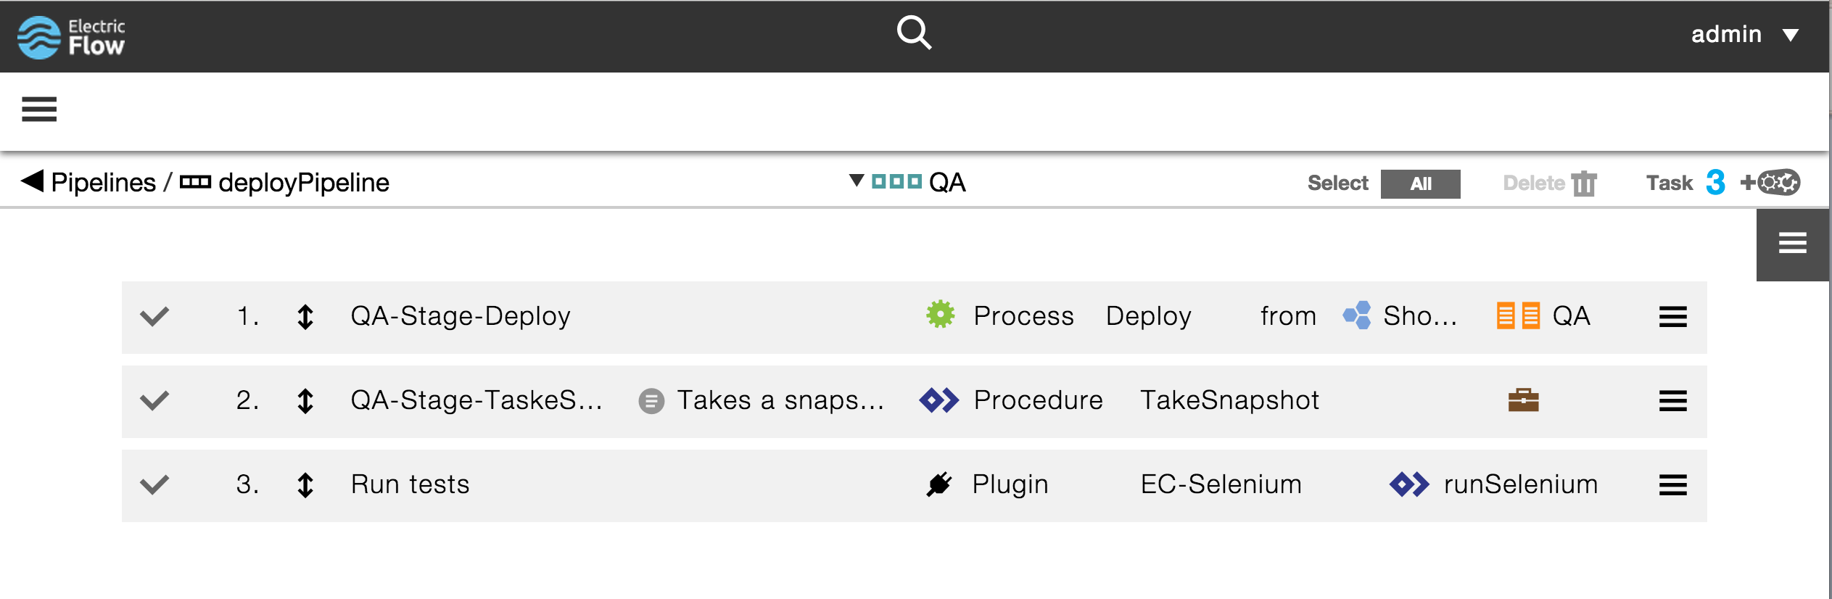








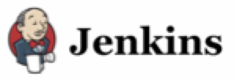




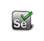













Integrate with external systems and tools
Notes:
Integrate with external systems and tools such as service management, testing, and infrastructure and cloud

Slide 23
Demo

Slide 24
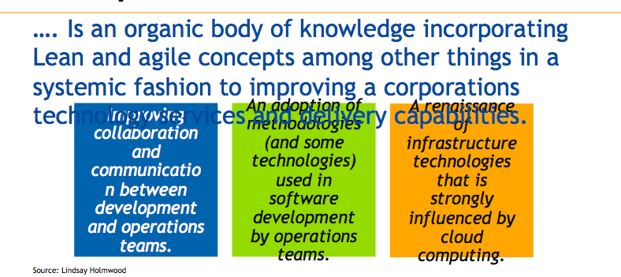
ElectricFlow: Differentiators
Allows Traditional Release Management + CD Pipeline Management in a single solution.
Natively integrated CI+ARA=CD solution.
Proven enterprise-class scalability.
Intuitive, easy-to-use and Mobile-ready UX.
Powerful DSL allows accelerated Application on-boarding.
Faster cycle times | More efficient delivery | Higher quality releases
Reduced cost of ownership | Increased end to end visibility

Slide 25






ElectricFlow Release
Coordinate tasks across teams with approvals and gates
Manage multi-app, multi-version, and multi-cloud payloads
Orchestrate pipelines through various stages and gates
Tracks and communicates status and details on 1-to-many releases
Ensures payload, process and environment consistency
Integrates with all of your tools and environments
It is about top down visibility so that release managers don’t have dig deep to find out how their release is doing, where is it stuck, who is it waiting for,
It is about control to clearly define the release payload and which versions get deployed to which environment
It is about helping release not a single application but multiple apps together on the game day.
Notes:
Visibility – How close to production is the software? What other team’s output are we dependent on? How are they progressing? What has been tested where? Where is it having problems? What versions are where? Is the software ready for production? Have all the quality gates been passed and the right people approved?
Feedback – What is the quality of the software? What tests got run on it? How many times did it fail on the way to production? How long is it likely to take?
Control – So many tools and tasks to create quality software. So much data to hand off. What is the next task? What about manual steps? Did Dev do static analysis before passing the software to QA? UAT must happen before the software is released. Don’t let the software into production until it’s passed all tests.

Slide 28
Backups

Slide 29
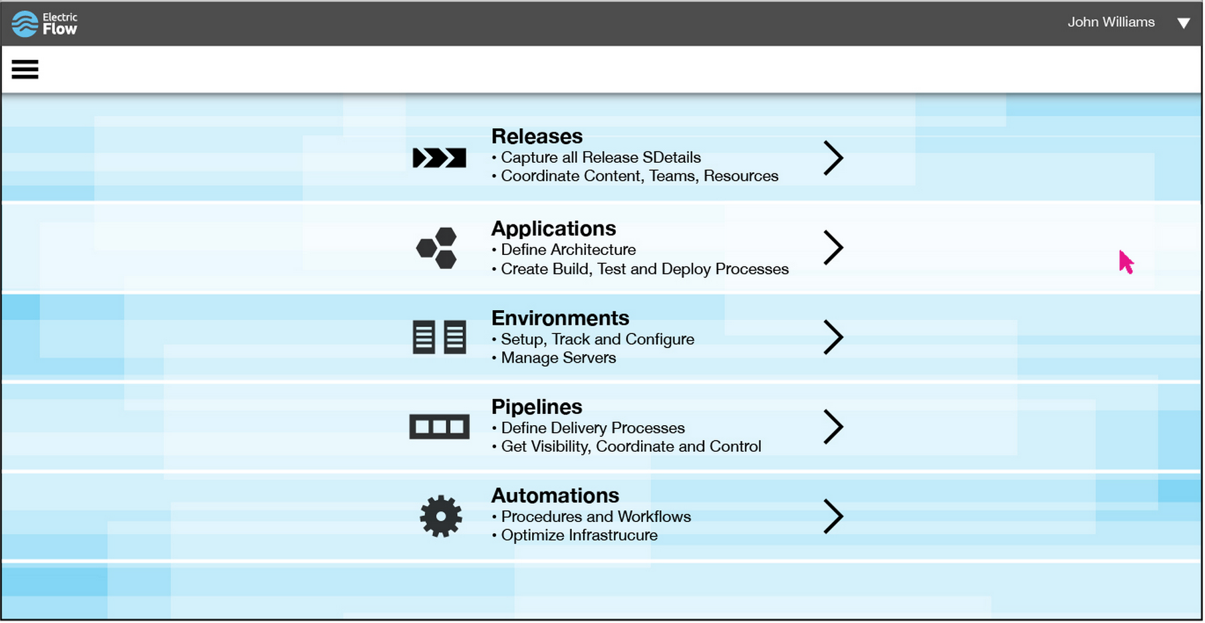


Slide 30
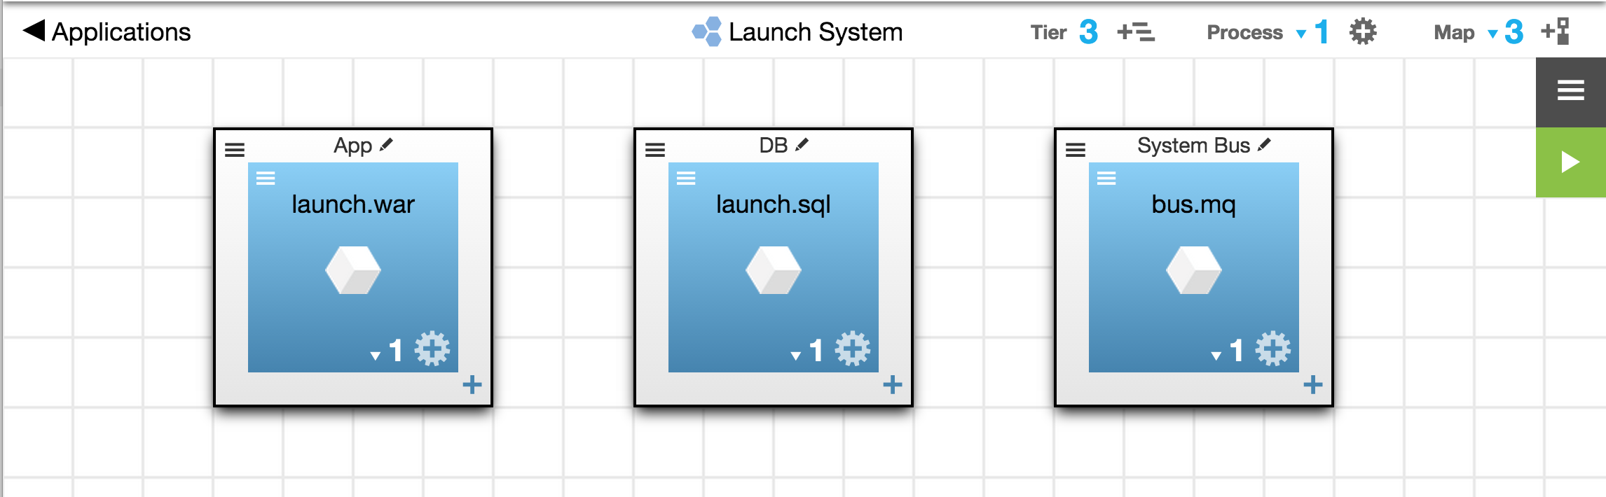
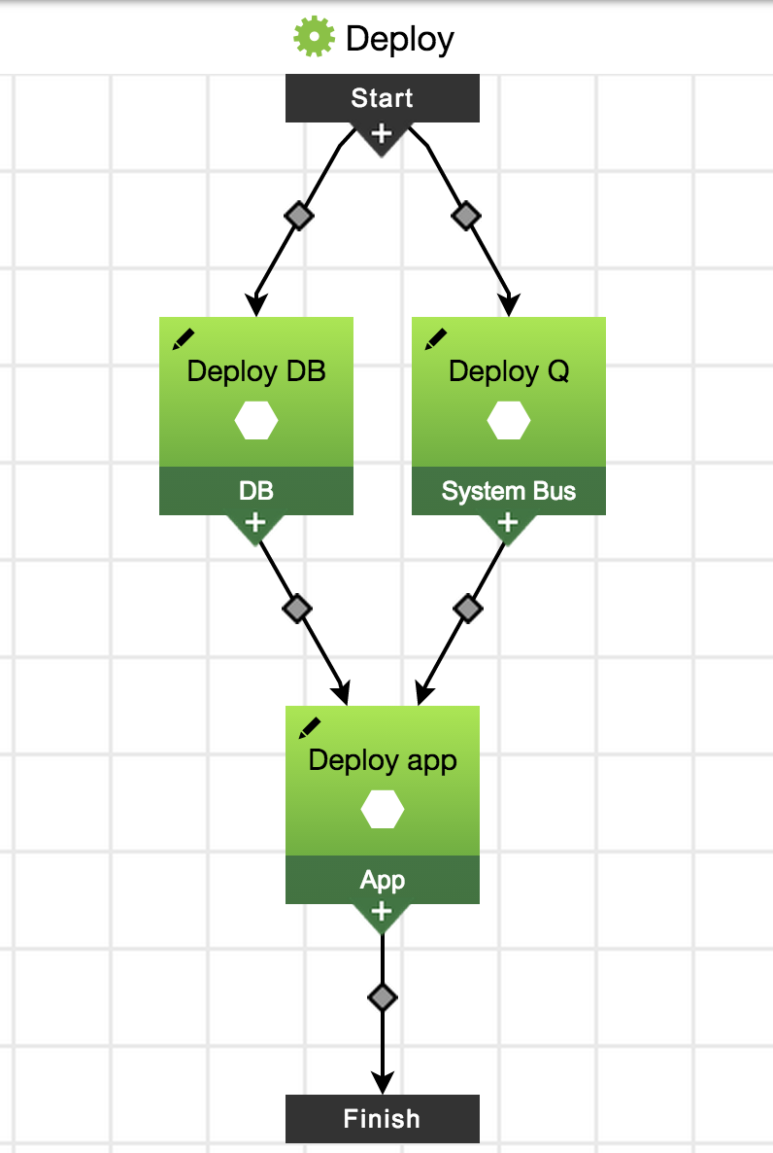
Application
Notes:
Model of developer build output (artifacts) that together provide a customer value. Plus the processes that go with them for deploying them to servers where they can provide the value. These are what we call Applications.

Slide 31
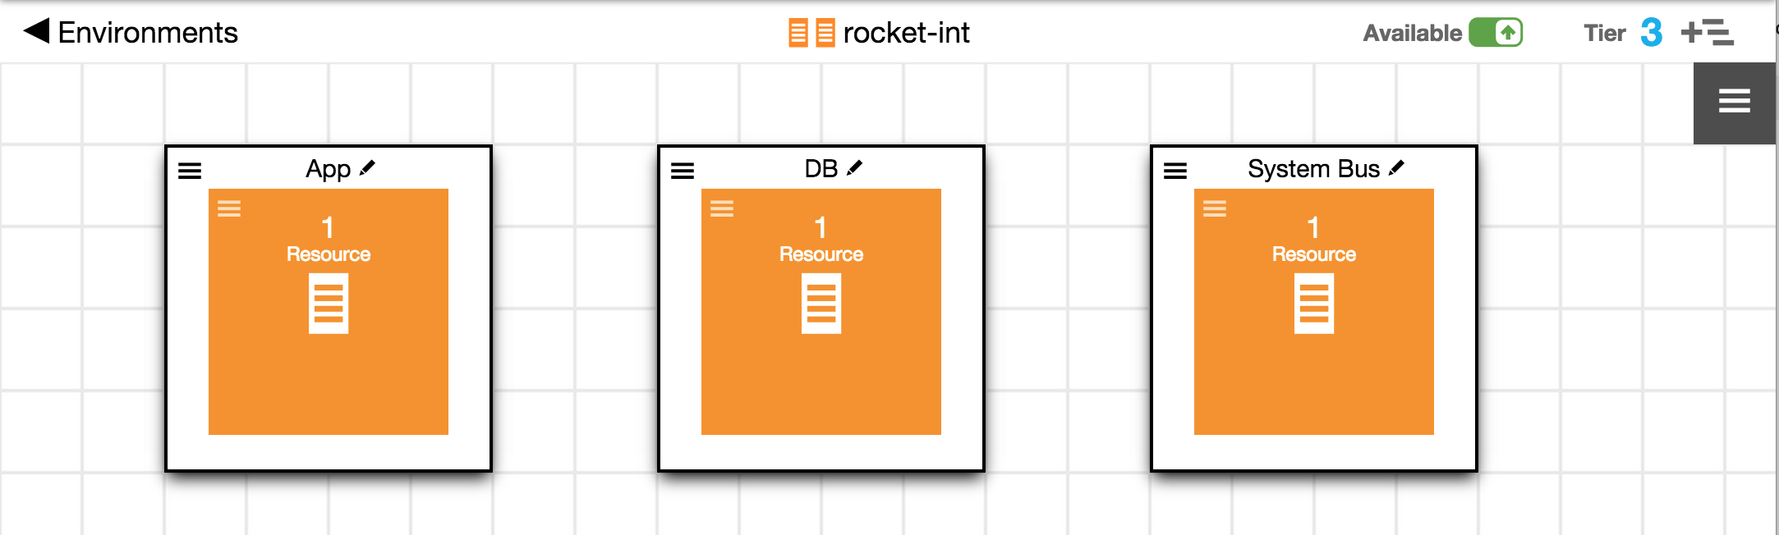
Deployed onto Environments
Notes:
And Applications get deployed onto environments. Environments are a collection of systems and system configurations that are designed for a particular purpose or service.

Slide 32
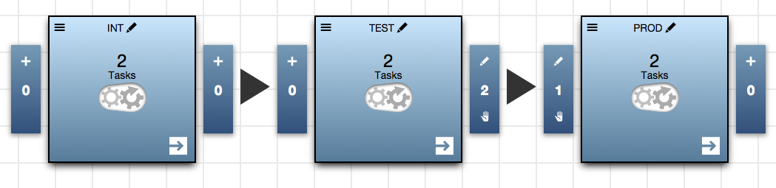


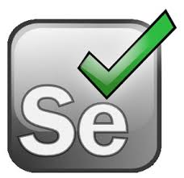
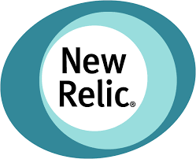
Notes:
One stage showing – and all this happens in a single stage of a pipeline (such as Integration)
3 stages showing – but the reality is that no one deploys to just one environment. So there are deploys to many stages for one app.
This is the pipeline.
Next is processes – and the deployment processes are just one of potentially many steps that happen in a stage. For example, other likely steps might be. . .
Build out and speak to – networking configs, updating service management, testing, and adding monitoring.

Slide 33
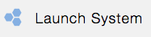
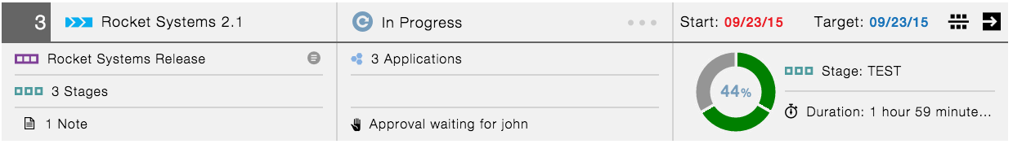

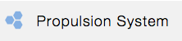
Release
Notes:
One pipeline showing - And that is all for just one Application.
Reveal other pipelines - But often times Releases are made up of output from several teams
And these teams all produce at least a few of their own release candidates
Reveal the last pipeline – And on their way to production they usually go through an operational integration stage.
These are all key parts of the release. Taking the release candidates, integrating them, testing, and then eventually pushing into production.
So we have focused around providing what is necessary for the release team to manage all of these releases effectively and efficiently.

Slide 34
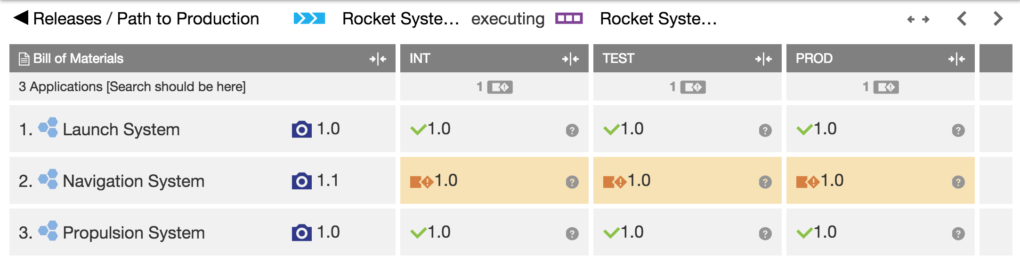
Notes:
For example, a release team needs to see if the release is moving forward or not. Is it past it’s milestone dates. Is it blocked waiting for someone to take action. How far along in the current pipeline run is it? What stage is it in?
And what we get asked by almost everyone we talk to. . . What is installed on which environments?
Let’s take a look at all of this in action. . .

Slide 35
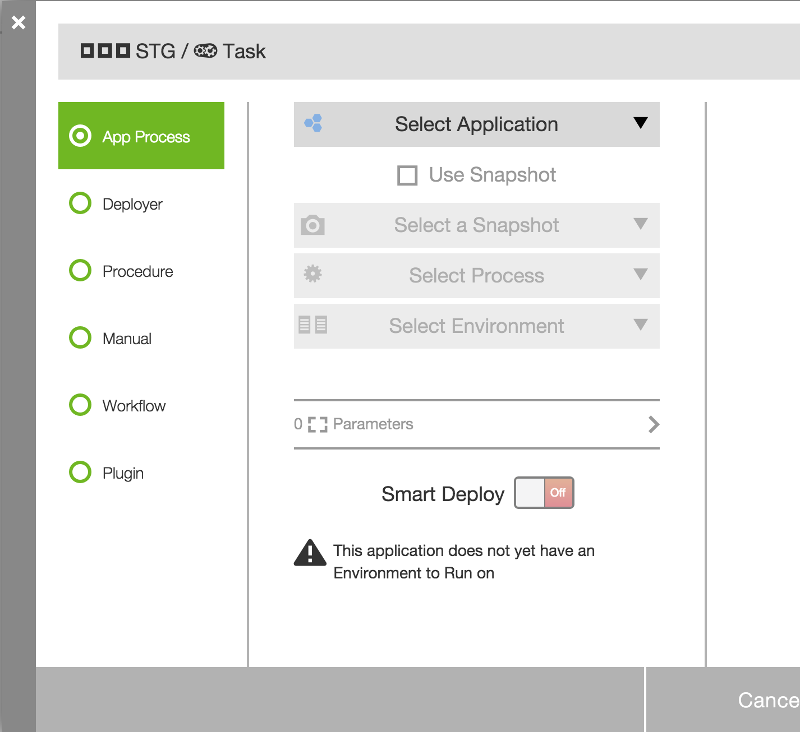
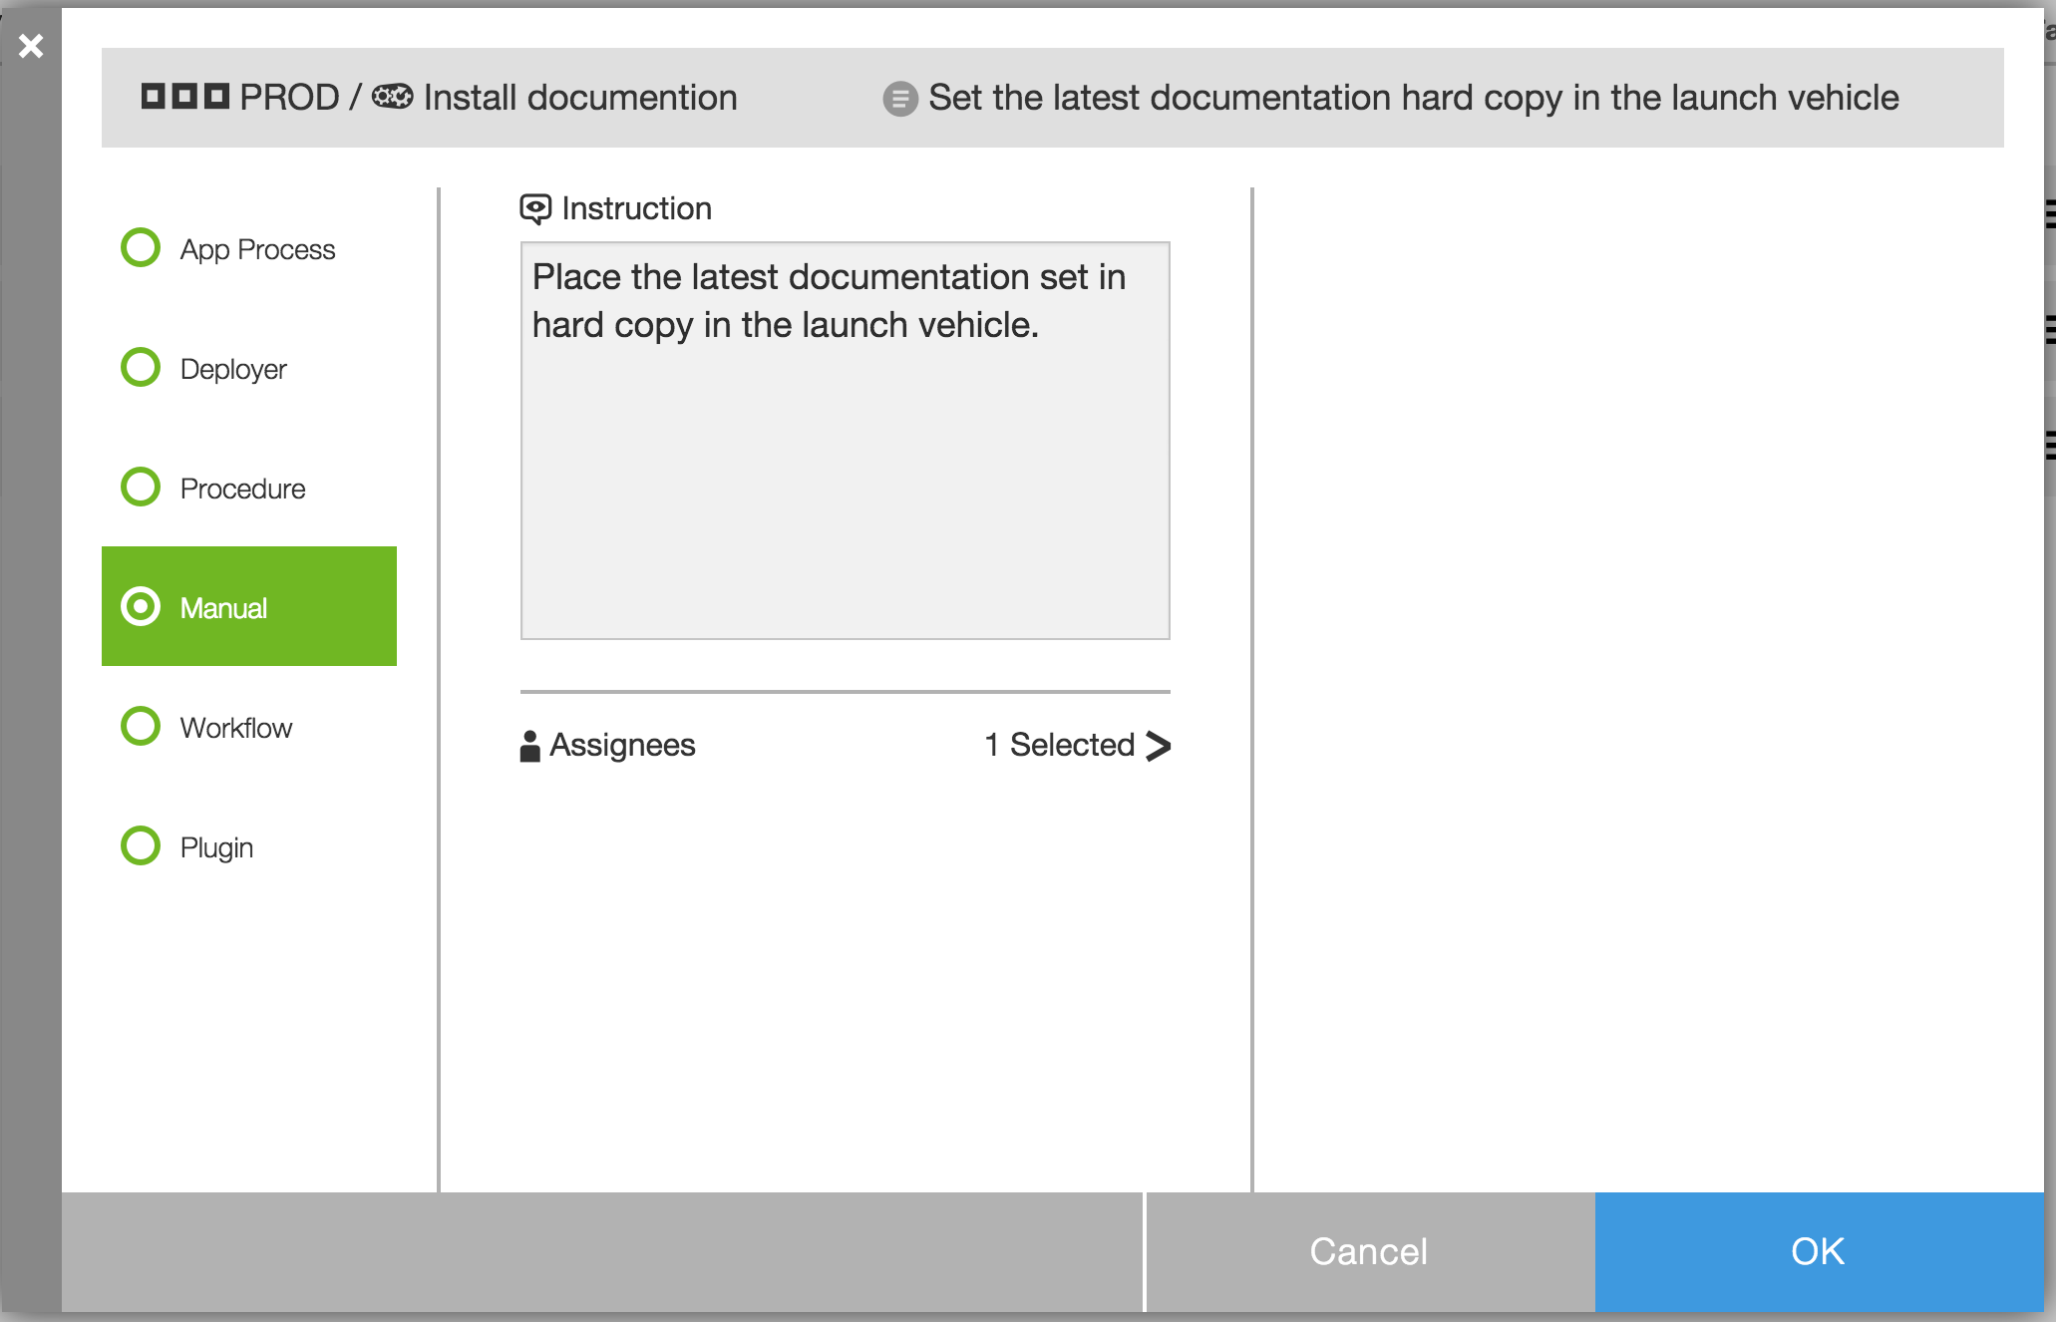
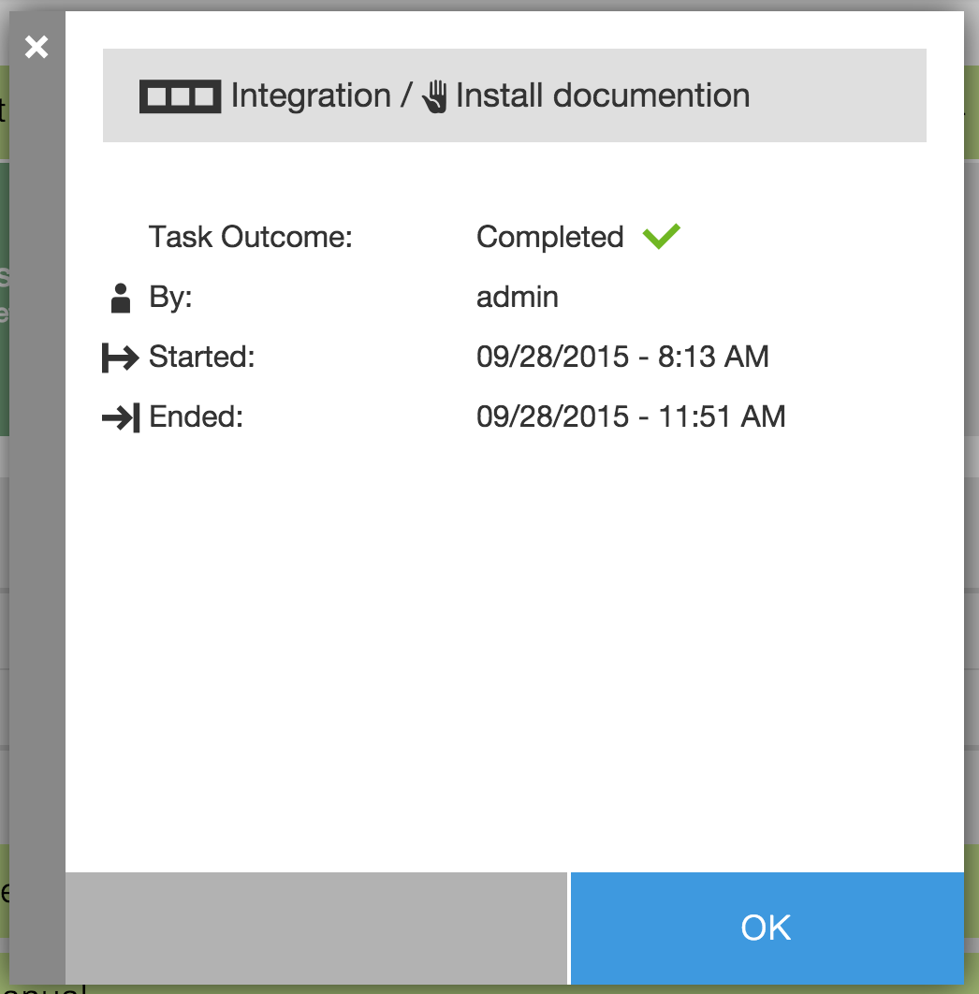
Coordinate between all release tasks
Mix automated and manual tasks
Optimizes automation and minimize waiting for people
Notifies and alerts users when the release needs their attention
Notes:
Track release tasks (manual and automated) and their responsible teams

Slide 36
CD = CI + ARA
Commit Pipelines
Release Pipeline
Dev
A
SCM
Build
Test
Publish
Uncontrolled Environments
Controlled Environments
Dev
B
SCM
Build
Test
Publish
Integ
Testing
Pre-Prod
Prod
Dev
C
SCM
Build
Test
Publish

Slide 37
Who’s Achieving CD?
100% of those surveyed
58% want fast software delivery (one of top 3 goals)
12% can do it
100
90
80
70
60
50
40
30
20
10
0
Survey completed by Forrester and Chef; 155 F1000 senior IT execs
Put another way. . .
46% want CD but are still doing some form of traditional release
88% overall are still doing some form of traditional release

Slide 38
Release Manager/Release Engineer Challenges
“I need to release not just one single application, but multiple applications successfully on the game day."
“ I have to support traditional releases” side by side with DevOps Initiatives that have much faster release cycles."
“I need to control and communicate the exact release payload and version, and know what has been deployed to which environment."
“I need top down visibility so I don’t have to dig around to find out how my release is doing, where it’s stuck, or who it’s waiting for."

Slide 39
The solution?
Complex use cases, “n” Applications
Frequent, small batches
Automated everything
Multiple dynamic environments
Loosely coupled components
Containers, micro-services
“12-factor” Apps
Electric Cloud is here
Traditional Release Management Tools are here
Traditional Release Mgmt
Continuous Delivery Pipelines / Release
“Big Bang” release planning
Multiple environments
Enterprise release calendar
Risk & Impact analysis
Resource reservations
Release plan approvals
CD Pipeline Tools are here
Simple use case, Few Applications
Notes:
Cover the idea of IOT vs. Web targets

